Slide 1

Architecture & asynchronous (redux & saga)
BDDF SOCLE - 2023

Slide 2
outline
Actual Status
Redux & Saga (flow and rules)
DO/ DON’T
Practice
Conclusion

Slide 3
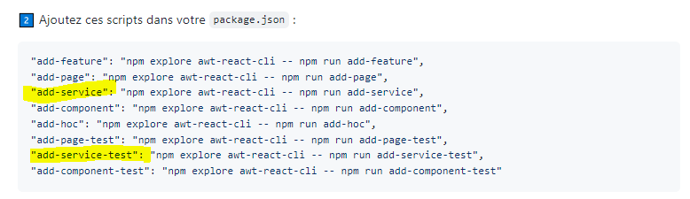
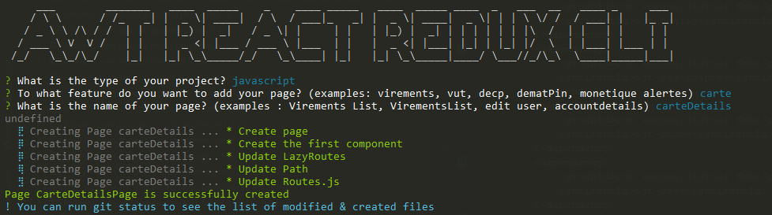


before starting …

Slide 4


Actual status
impure
I/O (http, disk, …)
saga
Redux
pages
Components (pure domain)
services
Side effects at the border!

Slide 5
Actual status
HTTP Requests
Redux (purify outside side effects)
Page (Class)
Main Component
(Pure Function)
Component 1 (Pure Function)
Component 2 (Pure Function)
Commons & Utils

Slide 6
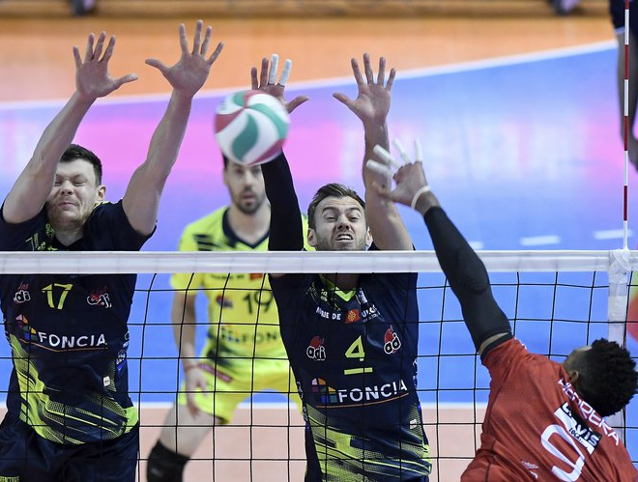
Actual status
Side effects
Saga
Page
Who will manage the side effects ?
Redux
React

Slide 7
what is a side effect?
Mutating(changing) the input(s) of the function.
1
Querying/Updating DOM
3
Logging(even in the console)
5
Making an XHR/fetch call.
6
Depending on an outer state.
2
Routing
7
Localstorage, session, cookie, global variable
4
Pure and Declarative components & functions
Inside pages (callback)

Slide 8
Page
props
request
Reducer
Reducer
Event: name, payload
Saga
ServiceA
Redux
Event: name, payload
Event: name, payload
Dispatcher
Event: name, payload
Event: name, payload
Event: name, payload
ServiceB

Slide 9


redux & saga

Slide 10
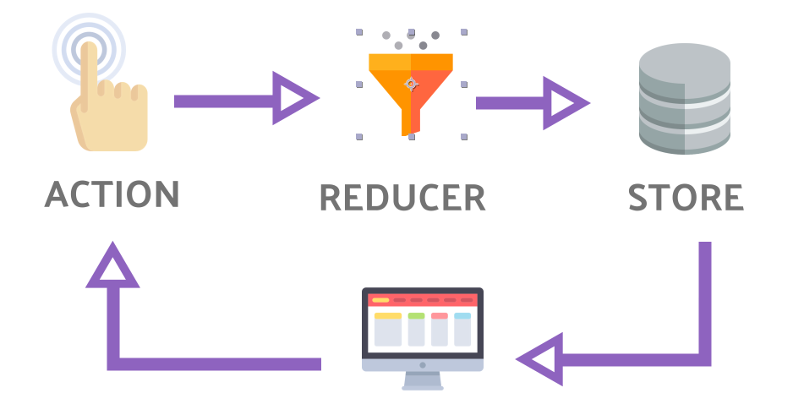
Redux & saga workflow
7
3
4
6
Saga
2a
2b
Backend
5
1
Pure domain

Slide 11
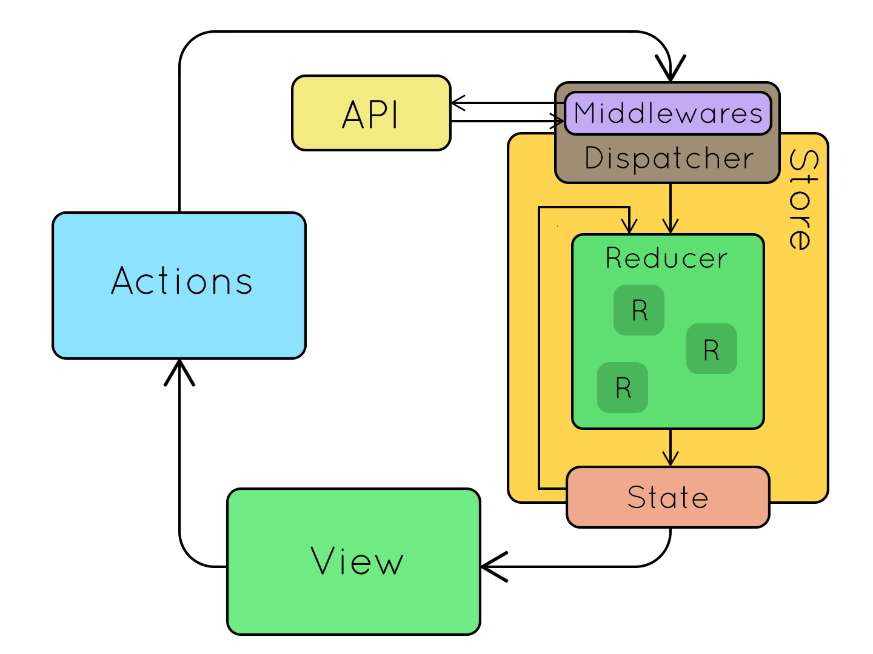
One-way communication flow

Slide 12
Actions types
{
type: SOU_CDG_CARTES_REQUEST,
payload: {
token: 123,
},
}
Loading
Error
Success
{
type: SOU_CDG_CARTES_REQUEST_ERROR,
error,
}
{
type: SOU_CDG_CARTES_REQUEST_SUCCESS,
data: cartesList,
}

Slide 13
Who dispatch actions ?
SOU_CDG_CARTES_REQUEST:
Page
SOU_CDG_CARTES_REQUEST_ERROR: Saga Service
SOU_CDG_CARTES_REQUEST_SUCCESS: Saga Service

Slide 14
Redux - Rules
Single source of truth.
State is readonly.
Reducers must be pure functions.
Reusable state fragments.
Reusable actions.

Slide 15

How does it work technically?

Slide 16
const SouCdgCartesReducer = (state = initialState, action) => Matcher() .on(() => action.type === SOU_CDG_CARTES_REQUEST, () => ({ ...state, loading: true, cartesListToDisplay: null, error: null, })) .on(() => action.type === SOU_CDG_CARTES_REQUEST_SUCCESS, () => ({ ...state, loading: false, cartesListToDisplay: action.cartesListToDisplay, error: null, })) .on(() => action.type === SOU_CDG_CARTES_REQUEST_FAILURE, () => ({ ...state, loading: false, cartesListToDisplay: null, error: action.error, })) .otherwise(() => ({}));
const SouCdgCartesFragment = state => ({ cartesListToDisplay: state?.SouCdgCartes?.cartesListToDisplay, souCdgCartesError: state?.SouCdgCartes?.error, souCdgCartesLoading: state?.SouCdgCartes?.loading, }); const SouCdgSelectCardProvider = { SouCdgCartesFragment, }; export default SouCdgSelectCardProvider;
4
receive state
update
import { SouCdgSelectCardProvider, SouCdgSelectCardDispatcher, } from '../../redux'; const { AwtContextFragment, SouCdgCartesFragment, } = SouCdgSelectCardProvider; @Reduxify(state => ({ // define state to extract ...AwtContextFragment(state), ...SouCdgCartesFragment(state), }), { // define actions to execute ...SouCdgSelectCardDispatcher, }) class SouCdgSelectCardFicheProduitPage extends Component {
5
update view
1
3
connect
update state
import SouCdgActionTypes from './SouCdgActionTypes'; const { SOU_CDG_CARTES_REQUEST, } = SouCdgActionTypes; const SouCdgSelectCardDispatcher = { requestCartesList: typeCarteIdCible => ({ type: SOU_CDG_CARTES_REQUEST, payload: typeCarteIdCible, }), }; export default SouCdgSelectCardDispatcher;
2
// did mount staff componentDidMount() { this.initPage(); } initPage = () => { const { typeCarteIdCible, requestCartesList, } = this.props; requestCartesList(typeCarteIdCible); };
dispatch

Slide 17
// render view render() { const { configuration, typeCarteIdCible, cartesListToDisplay, souCdgCartesError, souCdgCartesLoading, formSubmitError, } = this.props || {}; return ( <> {souCdgCartesLoading ? ( <LoadingView /> ) : ( <> {souCdgCartesError ? ( <SouCdgSelectCardErrorView errorType={souCdgCartesError} onBack={this.handleBack} onCallback={this.handleCallback} onSeeMore={this.handleSeeMore} onUpgrade={this.handleUpgrade} typeCarteIdCible={typeCarteIdCible} /> ) : ( <SouCdgSelectCardForm typeCarteIdCible={typeCarteIdCible} visuelInfo={null} cartesList={cartesListToDisplay} parcoursId={parcoursId} onNextStep={this.onNextStep} onCallback={this.handleCallback} onSeeMore={this.handleSeeMore} /> )} </> )} </> ); }
5
update view
6
Others logic
componentDidUpdate(prevProps) { this.handleTrackPage(prevProps); this.handleUpgradedTypeCarteId(prevProps); }

Slide 18
Actions
const SOU_CDG_CARTES_REQUEST = 'SOU_CDG_CARTES_REQUEST'; const SOU_CDG_CARTES_REQUEST_SUCCESS = 'SOU_CDG_CARTES_REQUEST_SUCCESS'; const SOU_CDG_CARTES_REQUEST_FAILURE = 'SOU_CDG_CARTES_REQUEST_FAILURE'; const SOU_CDG_SUBMIT_REQUEST = 'SOU_CDG_SUBMIT_REQUEST'; const SOU_CDG_SUBMIT_REQUEST_SUCCESS = 'SOU_CDG_SUBMIT_REQUEST_SUCCESS'; const SOU_CDG_SUBMIT_REQUEST_FAILURE = 'SOU_CDG_SUBMIT_REQUEST_FAILURE'; // SousCdg actions types const SouCdgActionTypes = { SOU_CDG_CARTES_REQUEST, SOU_CDG_CARTES_REQUEST_SUCCESS, SOU_CDG_CARTES_REQUEST_FAILURE, SOU_CDG_SUBMIT_REQUEST, SOU_CDG_SUBMIT_REQUEST_SUCCESS, SOU_CDG_SUBMIT_REQUEST_FAILURE, }; export default SouCdgActionTypes;
State changes causes

Slide 19
Dispatcher
import SouCdgActionTypes from './SouCdgActionTypes'; const { SOU_CDG_SUBMIT_REQUEST, SOU_CDG_CARTES_REQUEST, } = SouCdgActionTypes; const SouCdgSelectCardDispatcher = { requestSelectFormSubmit: data => ({ type: SOU_CDG_SUBMIT_REQUEST, payload: data, }), requestCartesList: typeCarteIdCible => ({ type: SOU_CDG_CARTES_REQUEST, payload: typeCarteIdCible, }), }; export default SouCdgSelectCardDispatcher;
Dispatch action

Slide 20
Reducers
const SouCdgCartesReducer = (state = initialState, action) => Matcher() .on(() => action.type === SOU_CDG_CARTES_REQUEST, () => ({ ...state, loading: true, cartesListToDisplay: null, error: null, })) .on(() => action.type === SOU_CDG_CARTES_REQUEST_SUCCESS, () => ({ ...state, loading: false, cartesListToDisplay: action.cartesListToDisplay, error: null, })) .on(() => action.type === SOU_CDG_CARTES_REQUEST_FAILURE, () => ({ ...state, loading: false, cartesListToDisplay: null, error: action.error, })) .otherwise(() => ({}));
How the state changes according to each action?

Slide 21
Provider
import { SouProvider, } from '../../commons/redux'; const { AwtContextFragment, } = SouProvider; const SouCdgFormSubmitFragment = state => ({ idTransaction: state?.SouCdgFormSubmit?.idTransaction, souCdgFormSubmitError: state?.SouCdgFormSubmit?.error, souCdgFormSubmitLoading: state?.SouCdgFormSubmit?.loading, }); const SouCdgCartesFragment = state => ({ cartesListToDisplay: state?.SouCdgCartes?.cartesListToDisplay, souCdgCartesError: state?.SouCdgCartes?.error, souCdgCartesLoading: state?.SouCdgCartes?.loading, }); const SouCdgSelectCardProvider = { AwtContextFragment, SouCdgFormSubmitFragment, SouCdgCartesFragment, }; export default SouCdgSelectCardProvider;
Reusable fragments

Slide 22
Compose reducers
R1
R2
R3
Reducer Root

Slide 23
Compose sagas
S1
S2
S3
Saga Root par feature

Slide 24
Compose reducers
const ReducerRoot = { awtContext: AWTContext, // SOU SouCartes: SouCartesReducer, SouError: SouErrorReducer, SouFormInput: SouFormInputReducer, SouCartesAndFormInput: SouCartesAndFormInputReducer, SouAdresseLivraison: SouAdresseLivraisonReducer, SouRecap: SouRecapReducer, SouRecapSign: SouRecapSignReducer, // SOU COL SouColVisuelInfo: SouColVisuelInfoReducer, SouColVisuelFormSubmit: SouColVisuelFormSubmitReducer, // SOU OPT SouOptFormSubmit: SouOptFormSubmitReducer, // SOU CDG SouCdgFormSubmit: SouCdgFormSubmitReducer, SouCdgCartes: SouCdgCartesReducer, SouCdgDebitInfo: SouCdgDebitInfoReducer, };

Slide 25
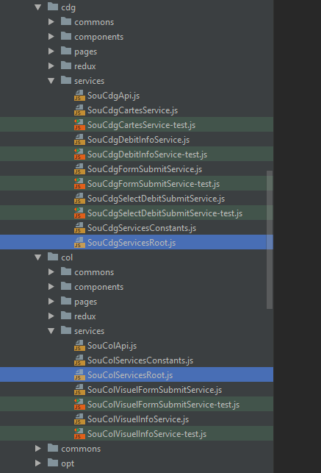
Compose saga
import { all, } from 'redux-saga/effects'; import SouServicesRoot from '../../sou/commons/services/SouServicesRoot'; import SouColServicesRoot from '../../sou/col/services/SouColServicesRoot'; import SouOptServicesRoot from '../../sou/opt/services/SouOptServicesRoot'; import SouCdgServicesRoot from '../../sou/cdg/services/SouCdgServicesRoot'; // add here all your saga service root export default function* rootSaga() { yield all([ ...SouServicesRoot, ...SouColServicesRoot, ...SouOptServicesRoot, ...SouCdgServicesRoot, ]); }
Reusable services

Slide 26
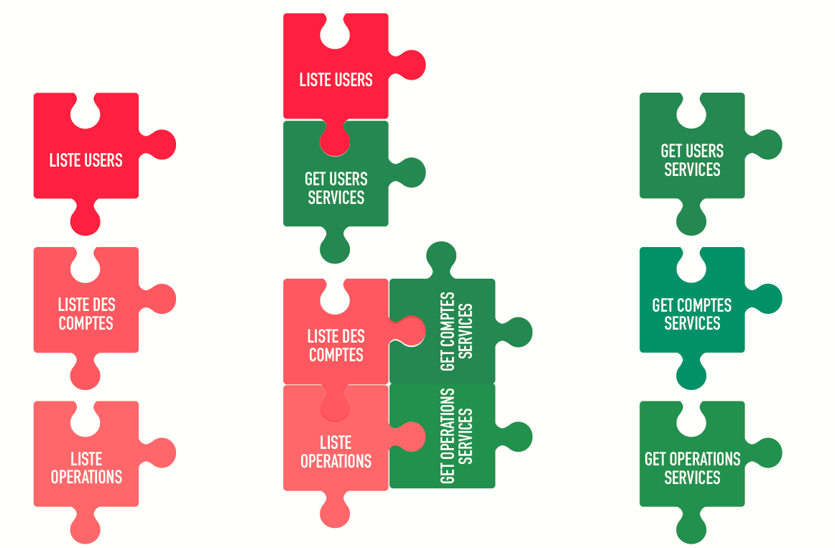

UI Atoms
Molecule : Page
Services Atoms

Slide 27

Final architecture
saga
Redux
pages
Components (pure domain)
services

Slide 28
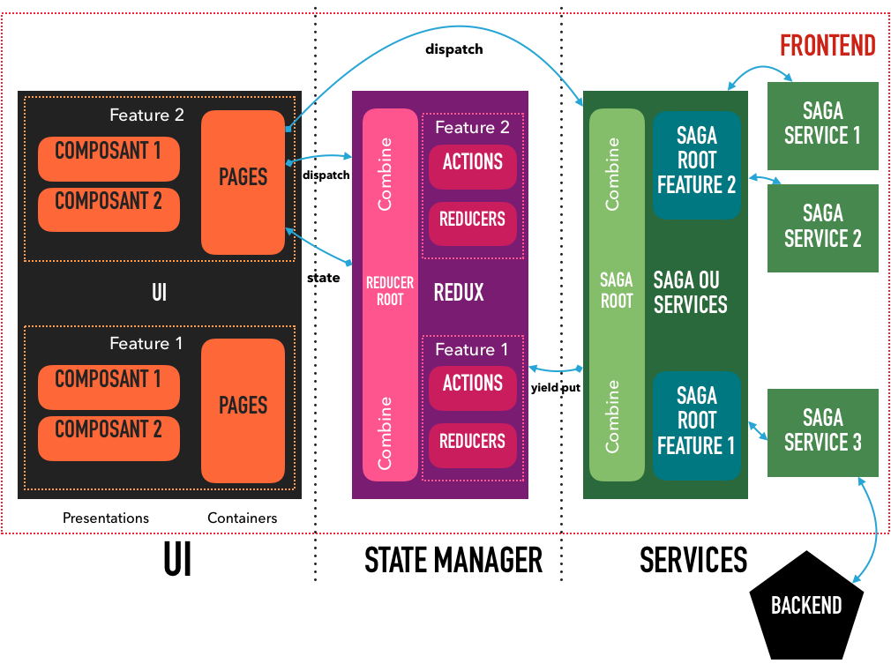
Final architecture

Slide 29

Do/don’t

Slide 30
Be careful when using redux hooks
Zombie children
Perfomance vs connect version (Reduxify)
https://xblocks.socgen/#/client/awt-react-optimisation-webpack?id=e-limiter-l39utilisation-de-useselector-redux

Slide 31

Use only reduxify version

Slide 32

Let’s see some code !

Slide 33
awt-react-cli tool
https://sgithub.fr.world.socgen/SocleDigitalClient/sg_npm_dgt_awt_react-cli#-awt-react-cli

Slide 34
Projects & references
http://socle.applis.bad.socgen/icd/demo/#/getting-started/awt-react-formation-architecture.md
http://socle.applis.bad.socgen/icd/demo/#demo/docs/client/awt-v4-architecture-front-react.md
http://socle.applis.bad.socgen/icd/demo/#demo/docs/client/awt-v4-phases-developpement-react.md
http://socle.applis.bad.socgen/icd/demo/#demo/docs/client/awt-v4-pattern-react.md
http://socle.applis.bad.socgen/icd/demo/#demo/docs/client/awt-v4-axios-redux-saga.md
https://sgithub.fr.world.socgen/AppliDigitalClient/bddf_awt_wtr/

Slide 35
conclusion
Pure
Immutable
Compose
Reuse

Slide 36



books

Slide 37

BDDF SOCLE 2023

